Slide 1
Muscle Models in OpenSim JAM
Colin Smith
10/31/2021

Slide 2
Overview
Notation, figures, and further details on muscle modeling can be found here:
OpenSim-JAM is only well tested for:
Millard2013EquilibriumMuscle
Millard, Matthew, et al. "Flexing computational muscle: modeling and simulation of musculotendon dynamics." Journal of biomechanical engineering 135.2 (2013).
$f^{T}=F\left(l^{T}\right) :$ Tendon force ($f^{T}$) is a function of tendon length ($l^{T}$)

Slide 3
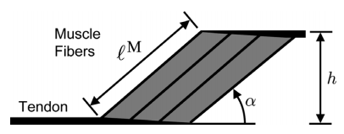

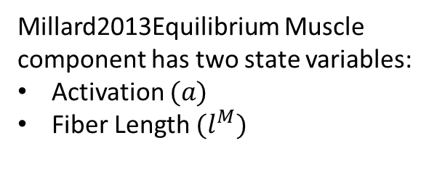




Muscle Tendon Unit (MTU) Kinematics
$$q$$
$$l^{MTU}=F\left(q\right)$$
$$l^{T}$$
$$l^{M}cosα$$
Millard2013Equilibrium Muscle
component has two state variables:
Activation $(a)$
Fiber Length ${(l}^{M})$
$$l^{MTU}=l^{M}cosα+l^{T}$$

Slide 4
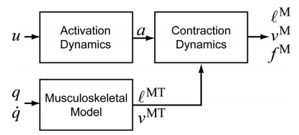

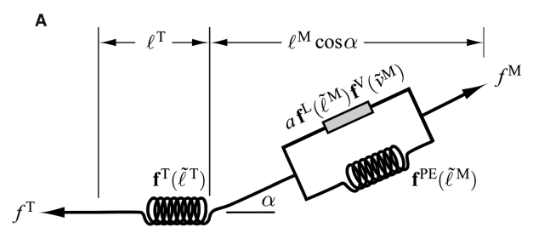
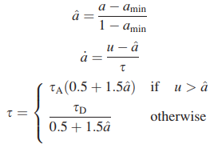
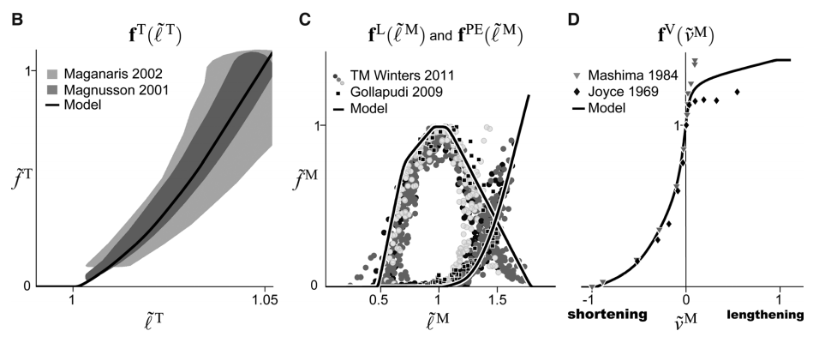












Muscle Tendon Unit (MTU) Dynamics
Contraction Dynamics
Active-Passive-Pennation-Tendon
$$l^{M}$$
$$v^{M}$$
$$f^{M}cosα=f^{T}$$
Activation Dynamics
$$e$$
Force-Length-Velocity
control
(excitation)
$$a$$
activation
$$f^{M}$$
use_tendon_compliance = false
use_activation_dynamics = false
$$f^{T}$$
Remove activation state
Remove fiber length state
$$e=a$$
$$l^{M}=F\left(q\right)$$
use_muscle_physiology = false
Remove activation state
Remove fiber length state
Neglect pennation
$$f^{T}$$
$$e=a$$
$$f^{M}={a ∙f}^{max iso}=f^{T}$$

Slide 5
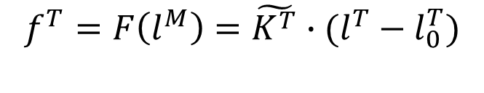


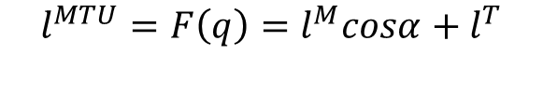










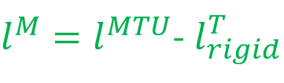
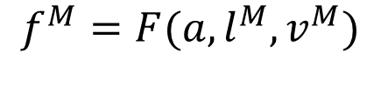
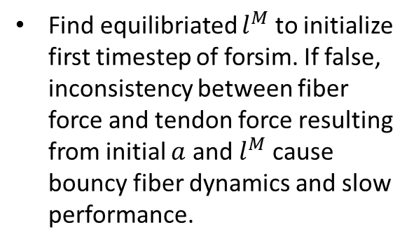
Equilibrate Muscles
THIS IS SIMPLFIED!! See Millard Journal of biomechanical engineering (2013) for Equilibrium vs Acceleration
$$q$$
$$l^{MTU}={F\left(q\right)=l}^{M}cosα+l^{T}$$
equilibriate_muscles = true
$$f^{M}$$
$$f^{T}$$
Find equilibriated $l^{M}$ to initialize first timestep of forsim. If false, inconsistency between fiber force and tendon force resulting from initial $a$ and $l^{M}$ cause bouncy fiber dynamics and slow performance.
$$l^{T}$$
$$l^{M}cosα$$
$$f^{M}=F(a,l^{M},v^{M})$$
use_tendon_compliance = false
Initial
muscle states
$l^{M}=l^{MTU}$- $l_{rigid}^{T}$
equilibrated
muscle fiber length
Iterate for $l^{M}$ until
$l^{M}$ removed as state
No iteration needed
$$f^{M}cosα=f^{T}$$
$$l^{M}$$
$$l^{M}$$
$$a$$
$$f^{T}={F\left(l^{M}\right)=\tilde{K^{T}}∙(l}^{T}−l_{0}^{T})$$
$\tilde{K^{T}}=F(l^{T})$: non-linear tendon stiffness
$l_{0}^{T}$: Tendon slack length

Slide 6
COMAK
COMAK Tool
Joint Mechanics Tool
use_muscle_physiology = false
(true not implemented)
use_muscle_physiology = false
_states.sto
input_states_file
Joint Angles Joint Speeds
Default Muscle Activation
Default Muscle Fiber Length
_activations.sto
input_activations_file
Muscle Activations

Slide 7
Forsim
Forsim Tool
Joint Mechanics Tool
use_activation_dynamics = true
use_activation_dynamics = true
use_tendon_compliance = true
use_tendon_compliance = true
use_muscle_physiology = true
use_muscle_physiology = true
_states.sto
input_states_file
Joint Angles Joint Speeds
Muscle Activation
Muscle Fiber Length
constant_muscle_control = 0.02
equilibriate_muscles = true

Slide 8
Forsim
Forsim Tool
Joint Mechanics Tool
use_activation_dynamics = false
use_activation_dynamics = false
use_tendon_compliance = true
use_tendon_compliance = true
use_muscle_physiology = true
use_muscle_physiology = true
_states.sto
input_states_file
Joint Angles Joint Speeds
No Muscle Activation
Muscle Fiber Length
constant_muscle_control = 0.02
equilibriate_muscles = true
_activations.sto
input_activation_file
Muscle Activations

Slide 9
Forsim
Forsim Tool
Joint Mechanics Tool
use_activation_dynamics = true
use_activation_dynamics = true
use_tendon_compliance = false
use_tendon_compliance = false
use_muscle_physiology = true
use_muscle_physiology = true
_states.sto
input_states_file
Joint Angles Joint Speeds
Muscle Activation
NO Muscle Fiber Length
constant_muscle_control = 0.02
equilibriate_muscles = true

Slide 10
Forsim
Forsim Tool
Joint Mechanics Tool
use_activation_dynamics = true
use_activation_dynamics = true
use_tendon_compliance = true
use_tendon_compliance = true
use_muscle_physiology = false
use_muscle_physiology = false
_states.sto
input_states_file
Joint Angles Joint Speeds
Default Muscle Activation
Default Muscle Fiber Length
constant_muscle_control = 0.02
equilibriate_muscles = true
_activations.sto
input_activation_file
Muscle Activations

Slide 11
Forsim
Forsim Tool
Joint Mechanics Tool
use_activation_dynamics = true
use_activation_dynamics = true
use_tendon_compliance = true
use_tendon_compliance = true
use_muscle_physiology = true
use_muscle_physiology = true
_states.sto
input_states_file
Joint Angles Joint Speeds
Muscle Activation
Muscle Fiber Length
constant_muscle_control = 0.02
equilibriate_muscles = true
_control
_activations.sto
input_activation_file
_activation
Muscle Activations
actuator_input_file
_force
_forces.sto
input_forces_file
Muscle Forces

Slide 12
Joint Mechanics Tool
Joint Mechanics Tool
use_activation_dynamics = true
override
use_tendon_compliance = true
use_muscle_physiology = false
_states.sto
input_states_file
Joint Angles Joint Speeds
Muscle Activation
Muscle Fiber Length
_transforms.sto
input_transforms_file
Body in ground
override
_activations.sto
input_activation_file
Muscle Activations
_forces.sto
input_forces_file
Muscle Forces

Slide 13
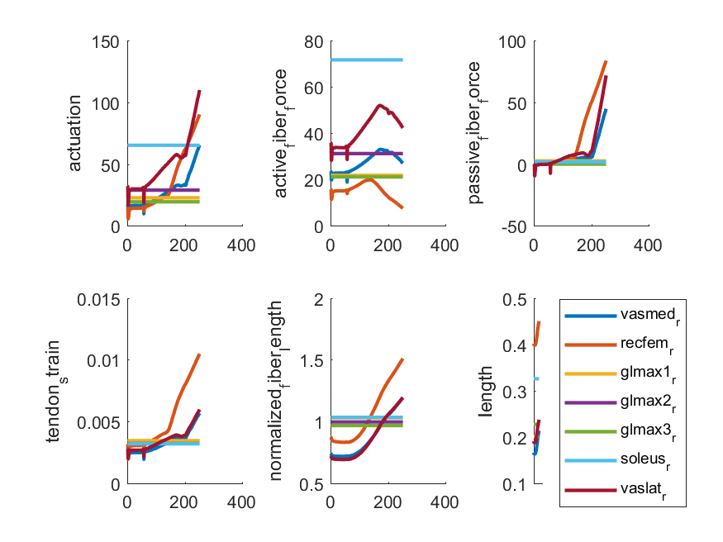
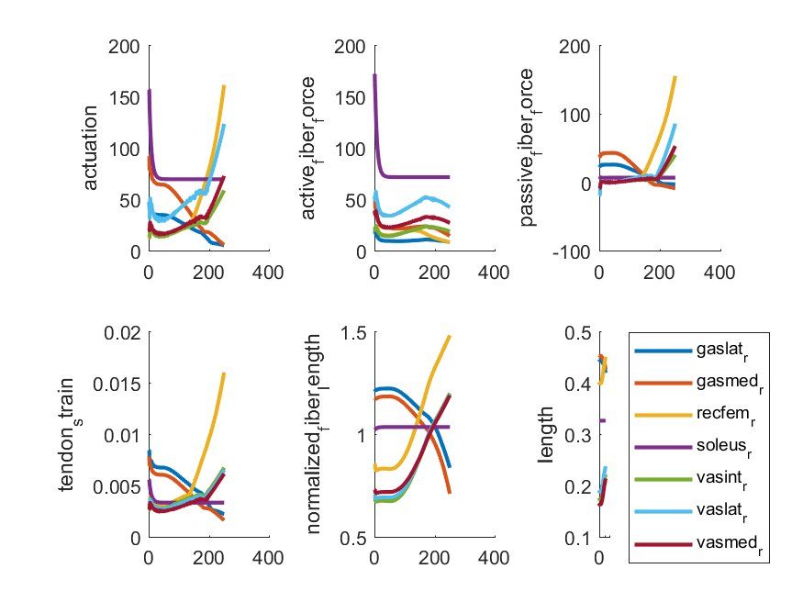

Slide 14
